Slide 1
One Dimensional Motion
Deriving formulas using a little calculus
Area under the curve

Slide 2
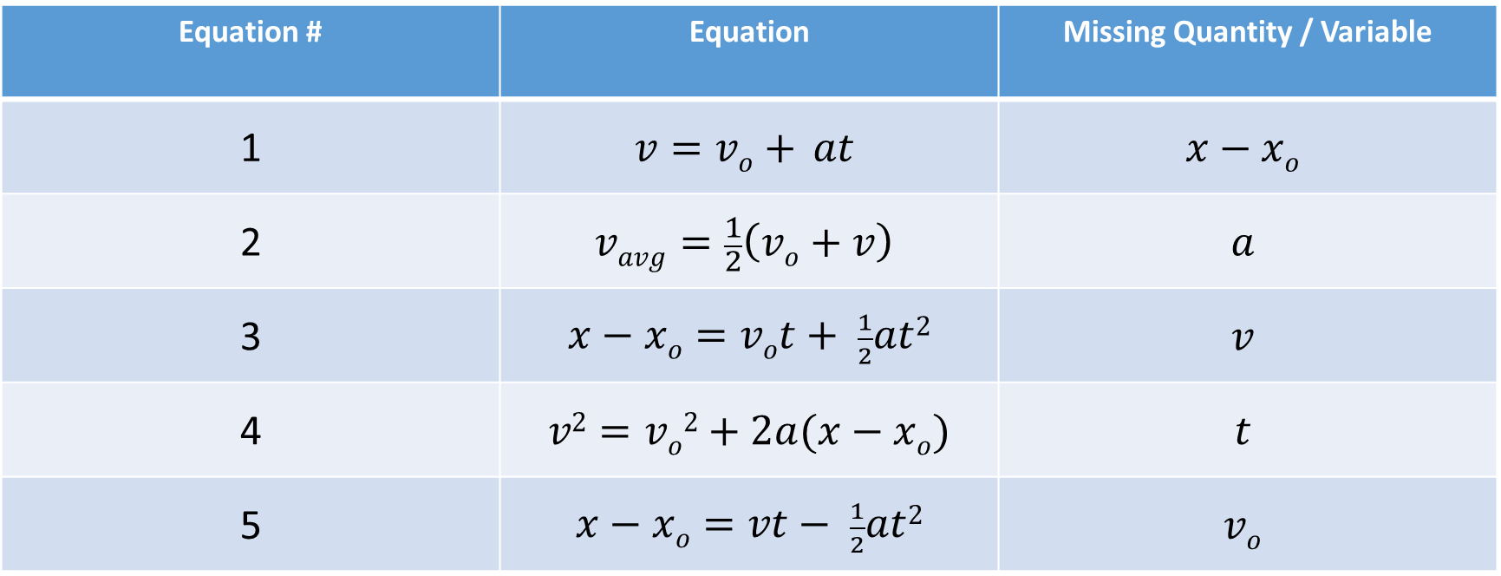
The “BIG FIVE” for Physics when the Acceleration is Constant.
Equation # | Equation | Missing Quantity / Variable
1 | $$v=vo+ at$$ | $$x−xo$$
2 | $$vavg=\frac{1}{2}\left(vo+v\right)$$ | $$a$$
3 | $x−xo=vot+ \frac{1}{2}at$² | $$v$$
4 | $v2=vo2+2a(x−xo$) | $$t$$
5 | $x−xo=vt− \frac{1}{2}at$² | $$vo$$
If you look at the last set of notes where we derived the BIG FIVE with algebra, we exclusively used Equations (1) and (3) to solve for (4) and (5).

Slide 3


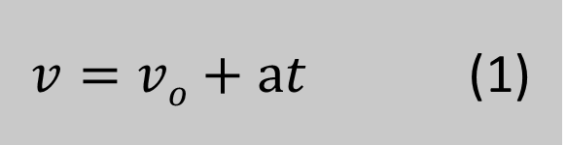

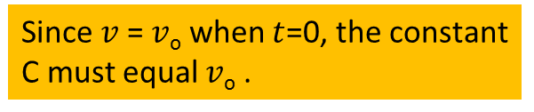

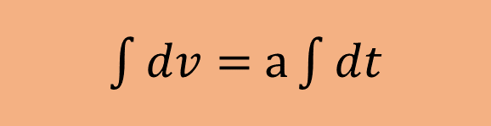
$$a=\frac{dv}{dt}$$
$dv=$ $adt$
Solve for $dv$
We will now integrate both sides.
$\int{dv}=$ $a\int{dt}$
Since the acceleration is constant, we can move it outside the integral.
$v=$ $at$+ C
Since $v$ = $v$_{o} when $t$=0, the constant C must equal $v$_{o} .
We can rewrite the equation to show that it is indeed the same as equation (1).
$v=vo+at$ (1)

Slide 4


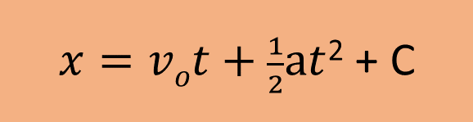

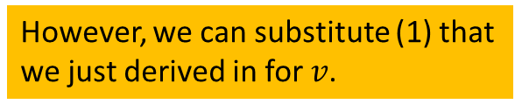
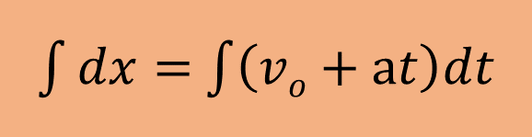
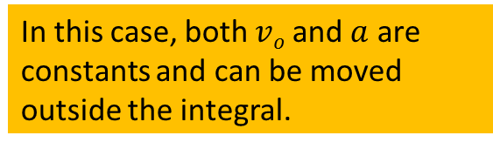
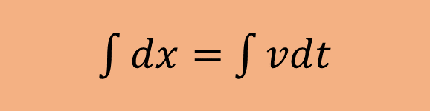
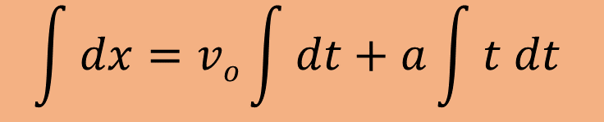
$$v=\frac{dx}{dt}$$
$dx=$ $vdt$
Solve for $dx$
We will now integrate both sides.
$\int{dx}=$ $\int{vdt}$
In this case, since the speed is NOT constant, we cannot move it outside the integral.
$\int{dx}=$ $\int{\left(vo+at\right)dt}$
However, we can substitute (1) that we just derived in for $v$.
We can rewrite the equation as follows
$$\int{dx}=vo\int{dt+a\int{t dt}}$$
In this case, both $vo$ and $a$ are constants and can be moved outside the integral.
$x=vot+\frac{1}{2}at$² + C

Slide 5
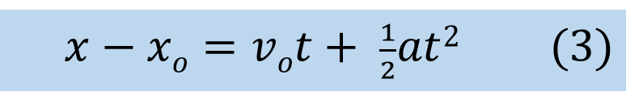
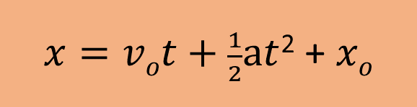
If we now plug in 0 for $t$, you will see that C must be the starting position $xo$.
$x=vot+\frac{1}{2}at$² + $xo$
Rearranging for $x−xo$ gives us…
$x−xo=vot+ \frac{1}{2}at$² (3)
With the exception of (2), the other two formulas (4) and (5) can be derived using integral calculus instead of algebra!

